Slide 1



Pharmacotherapy in children – small populations of human subjects who are not just small adults
Hanneke van der Lee, MD, PhD

Slide 2
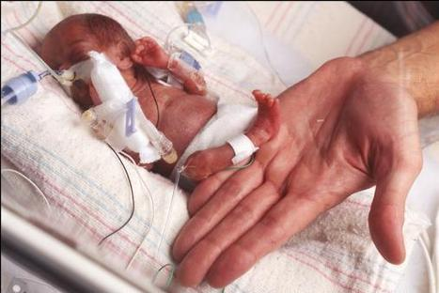
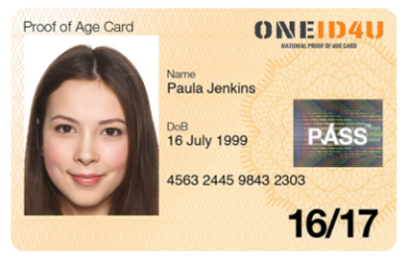
Children?

Slide 3
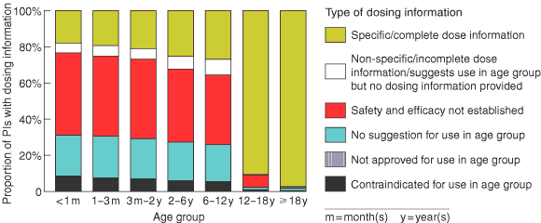
‘…no adequate scientific basis info for 80% of prescription medicines.’
Tan et al. MJA 2003
Notes:
3

Slide 4
Brief history of drugs in children
Disasters:
  1937 Sulphanylamide
  1956 Sulphisoxazole
  1959 Chloramphenicol
  1982 Benzyl alcohol
Legislation to stimulate drug research in children
  1997 FDA Modernization Act
  2002 Best Pharmaceuticals for Children Act
  2007 European Paediatric Regulation

Slide 5
Drug and human body (1)
‘drug’: active ingredient + excipient
Route of administration:
  Oral: capsule, tablet, fluid, …
    sublingual
  Intravenous
  Rectal
  Intramuscular
  …..

Slide 6
Drug and human body (2)
Absorption
Distribution
Metabolism
Excretion
Relation between concentration and effect:
Pharmacodynamics, PD
Pharmacokinetics, PK

Slide 7
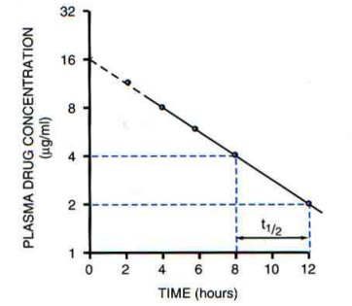
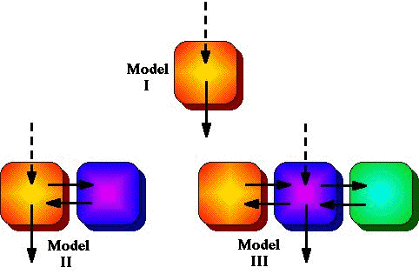
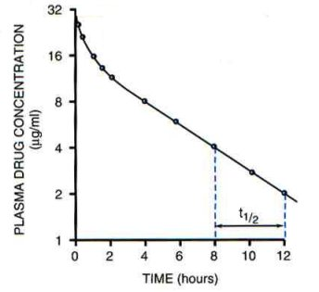
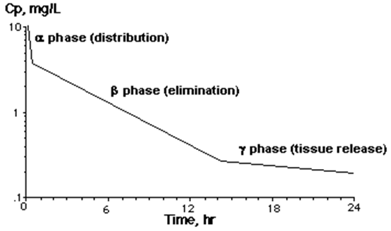
PK models

Slide 8

Changes during development
Absorption
Distribution
Metabolism
Excretion
PD
Gastric pH, intestinal function
Body composition, availability of binding
proteins, permeability of membranes
Expression of enzymes in the liver
Renal function
Availability of receptors, drug-receptor interaction

Slide 9
Kearns et al. NEJM 2003

Slide 10
PK/PD studies
Adults:
12 blood samples taken in 24 hours
(Data-rich approach)
Children:
Population approach
De Cock et al. Eur J Clin Pharmacol 2011

Slide 11
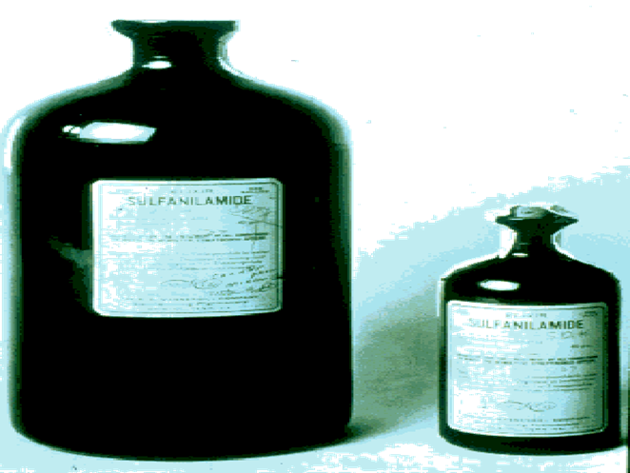
What is the right dose?
Not useful:
  Calculate based on weight or BSA
  80% of the adult dose
Recent developments:
  Extrapolation
  Modelling and simulation

Slide 12
Extrapolation …
‘use of data (in vitro, in silico, PK, PD, safety, efficacy) acquired in one population and/or experimental setting to make inference about another population of interest.’
Dose
Efficacy
Safety
Assumptions for sample size calculations

Slide 13
FDA decision tree

Slide 15
EMA review

Slide 16
Way forward
Empirical data are always needed
Make use of available data
Stimulate paediatricians to improve the quality of their (clinical) data
Don’t just do ‘what we always do’, but develop new methods

Slide 17
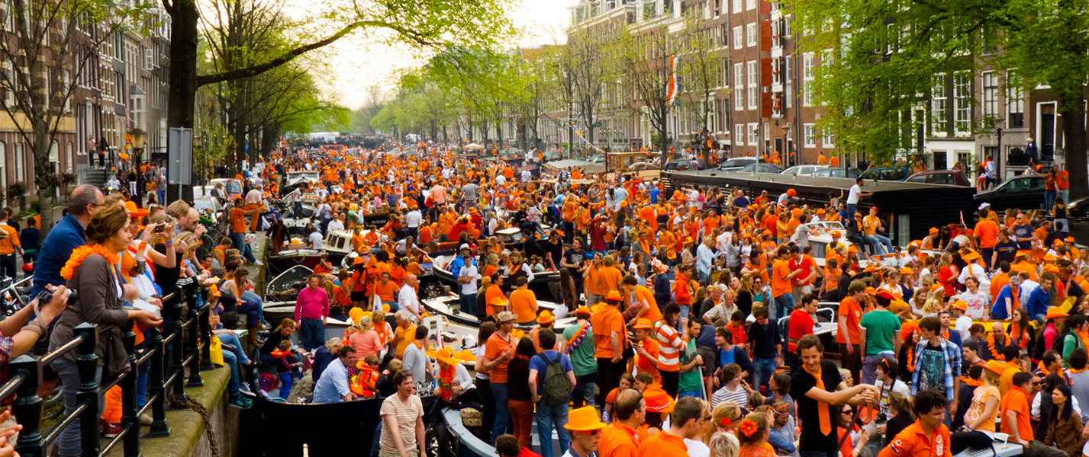
Thank you!

